Slide 1
LCMP Functional Specification 11th of June 2017 v1.3
Mission, Vision, Strategy
Annual review
Link LCMP to Pronto
Update Eqmt Strategies
Refine Eqmt Strategies
LCMP Dashboard
Review Eqmt Strategies
Mobile Fleet Maintenance
Life Cycle Management Plant

Slide 2
The LCMP is a tool to give Mobile Fleet Maintenance leadership visibility on five areas, based on the equipment strategy
Planned maintenance activities and schedule
What are we going to do and when? This link to Pronto
Estimate of unplanned maintenance
How much unplanned breakdowns are we expecting per year?
Costs/budgeting
What is the total cost (labour+materials) of planned and unplanned maintenance?
Equipment availability forecast
How does the planned and unplanned maintenance affect overall availability?
Manning estimation
How many maintainers required based on maintenance labour hours?

Slide 3

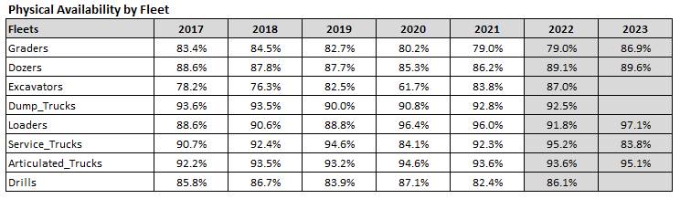
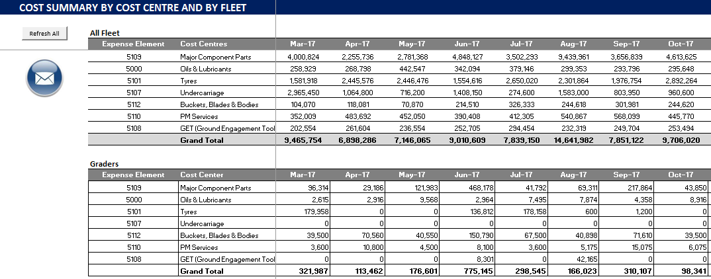
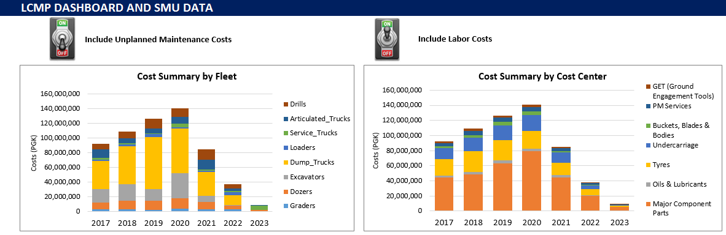
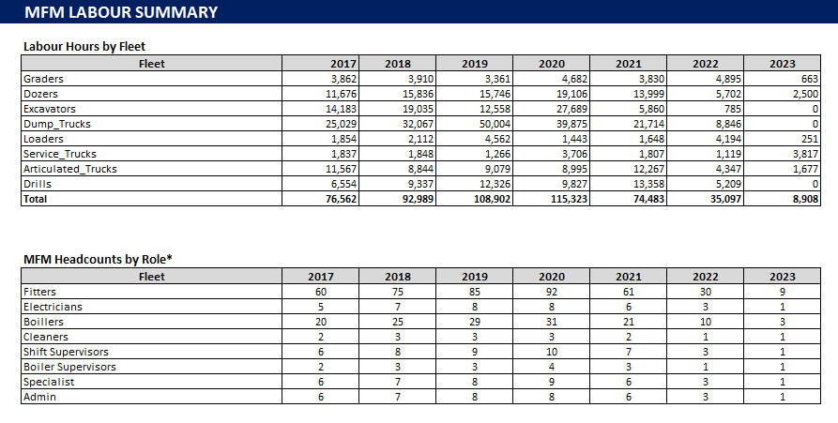
Five core functionalities are designed to enable LCMP achieve that visibilities
Function | Input | LCMP | Output
Planned maintenance | Equipment strategies Frequency & SMU hrs |  | Planned Schedule Planned hrs
Unplanned maintenance | Planned hrs Unplanned ratio |  | Unplanned hrs Downtime hrs
Budgeting | Downtime hrs Material & labour costs Oil & lubricant costs Tyres costs |  | Budget by cost-centre Budget by fleet
Equipment strategy | Equipment SMU hrs Equipment status (ON/OFF) |  | Cost by fleet Equipment availability
Labour estimation | Downtime hrs Labour productivity |  | Labour estimation
Schedule for PM
Availability for Ops
Budget for Finance
LCMP Dashboard
Headcount for HR

Slide 4
LCMP Functional Specification (note, MVP¹ is colour-coded with )
MVP
¹ MVP = Minimum Viable Product

Slide 5
LCMP tool is used to review equipment strategy periodically to ensure alignment with the organization mission, vision, and strategy
Mission, Vision, Strategy
Annual review
Add New Eqmt
Pronto input table
Link LCMP to Pronto
Update Eqmt Strategies
Update Eqmt Strategies
Track different between Pronto-LCMP
Update Tyres, Oils, and Labour Assumptions
Turn ON/OFF Eqmt
Refine Eqmt Strategies
Review Costs/Budget
LCMP Dashboard
Review Eqmt Strategies
Change Eqmt Strategies
Review Availability
Key:
Process
Output
Input/Output

Slide 6
LCMP tool contains three main components: 1) Input or assumption sheets, 2) Process or analysis sheets, and 3) Output or dashboard sheets
I NPUT
O UTPUT
PROCESS
Input component | Process component | Output component
Update New Edit Lubricant Costs Tyres Costs | Equipment strategy & schedule Graders Dozers Excavators Dump Trucks Loaders Service Trucks Articulate Trucks Drills Analysis Costs per operating hours Costs by cost-centre Costs by equipment | Dashboard Charts
Equipment aging input Tyres input Labour input |  | Cost Summary Cost by Equipment Cost by Activity Labour Sumarry
Constant
Variable

Slide 7
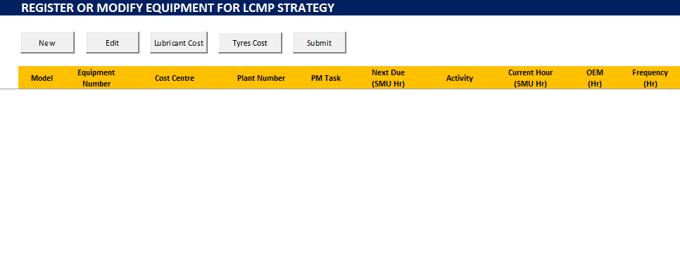
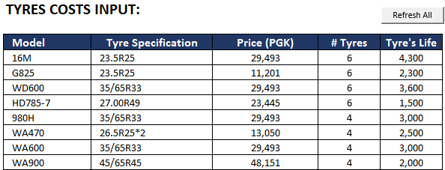
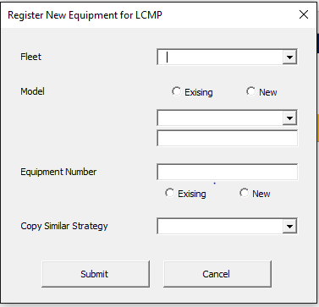
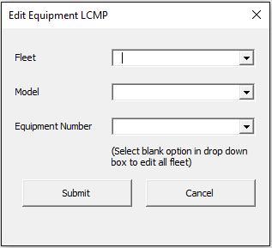
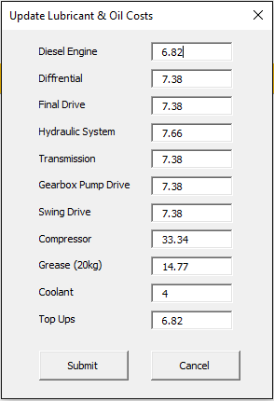
Update sheet is used to input hard-data such as new equipment, edit equipment, update lubricants costs, and update tyres information
IN
PROCESS
OUT
MVP
User form to update tyres’ life and costs
User form to add new equipment into LCMP master. Either create new or copy from existing strategy
User form to edit existing equipment strategy. Either by eqmt or by fleet/group of eqmt
User form to update oils and lubricants costs
The update sheets are mostly doing copy-paste data from one sheet to another or input-output function

Slide 8
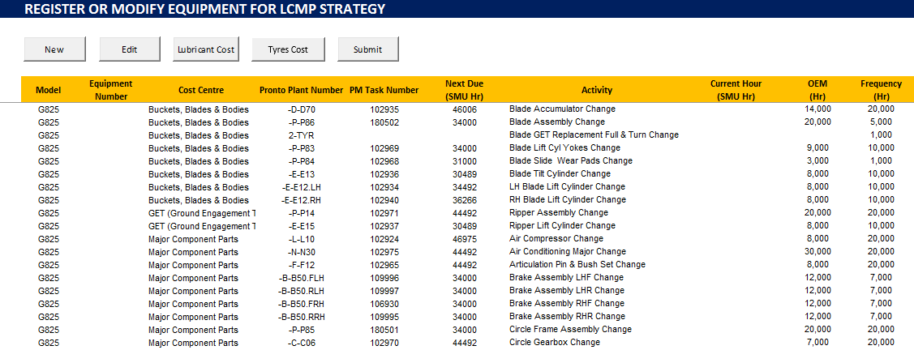
Example of new equipment strategy created using “New” function which copy strategies from existing equipment
IN
PROCESS
OUT
MVP
Once updated, user has to hit submit button to upload eqmt strategies into database
All activities, SMU hr, frequency, and costs are copied from existing equipment
All maintenance strategies information will go to LCMP master sheets (See Page-13)

Slide 9
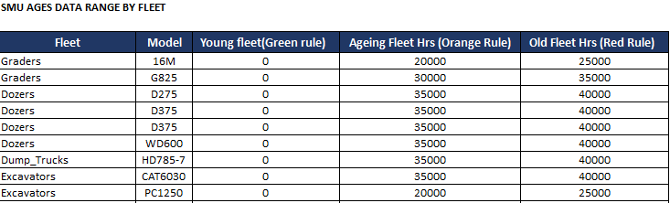
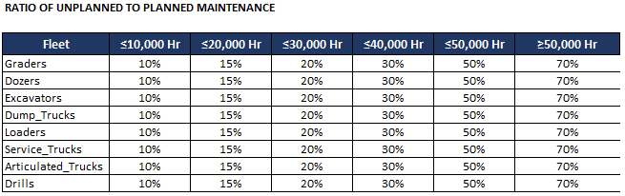
Age data inputs is used to input assumptions related with equipment, such as aging definition and ratio of planned:unplanned maintenance
IN
PROCESS
OUT
MVP
Aging definition to determine when eqmt defined as Young/Old. This will be reflected in LCMP dashboard sheet (Red/Yellow/Green).
Planned : Unplanned will determine magnitude of unplanned hrs as a function of planned hours. It will also impact the costs calculation
Equipment assumptions will impact the calculation of unplanned down hours, maintenance costs, and availability

Slide 10
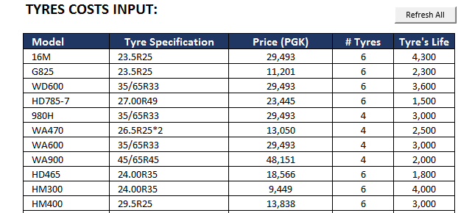
Tyres input is used to update assumptions related with tyres, such as: tyres specification include # tyres, tyres costs, and tyres life
IN
PROCESS
OUT
MVP
Tyres life play important roles in determining tyre costs, the longer the life, the lower the costs. It highly dependent on the road conditions
Tyres costs are updated regularly following market prices
Mobile fleet maintenance leadership run the tyre scenario to build business case for fixing the road
Tyres assumptions will impact the calculation of planned down hours, maintenance costs, and availability

Slide 11
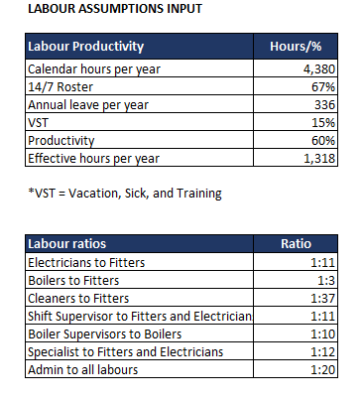
Labour input is used to input assumptions related with labour, such as labour productivity, span of control, support function to front-line ratios
IN
PROCESS
OUT
Labour productivity assumptions such as working hours, productive hours, and VST will determine the total effective hours per employee
Labour assumptions will impact the calculation of headcounts required or labour estimation
Qualitative measures such as span of control, labour ratios are used to estimate Supervisory roles, and support function roles such as admin staff, cleaners, etc.

Slide 12
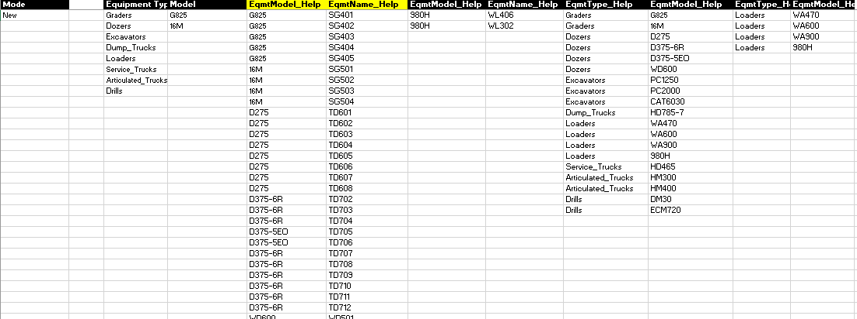
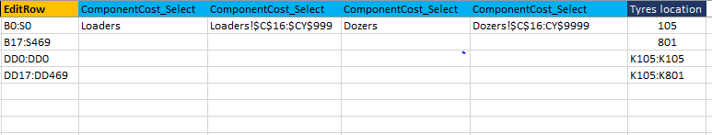
Index sheet is used to stores all lookup information, such as: the drop-down list for equipment, formulas, and equipment mapping
IN
PROCESS
OUT
Drop down list in add new equipment form
Equipment to fleet mapping
Dropdown list in add new equipment user form
Index mostly used to populate the drop-down list and indexing location of existing strategies
Formula for indexing equipment location

Slide 13
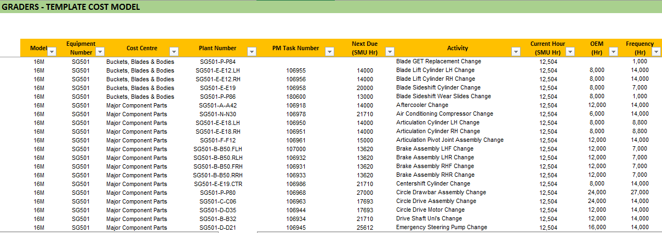
LCMP master sheets are used to maintain equipment strategies information such as PM activities, frequency of PM, costs, etc.
IN
PROCESS
OUT
MVP
PM activities are defined by mobile fleet maintenance leadership
Cost centre used to generate budgeting or costs breakdown for Finance
Frequency of PM activities which will determine the schedule pattern
Plant number is an unique identifier used for link to Pronto
LCMP master sheets contains all maintenance activities and strategies which will determine PM schedule, costs, and availability

Slide 14
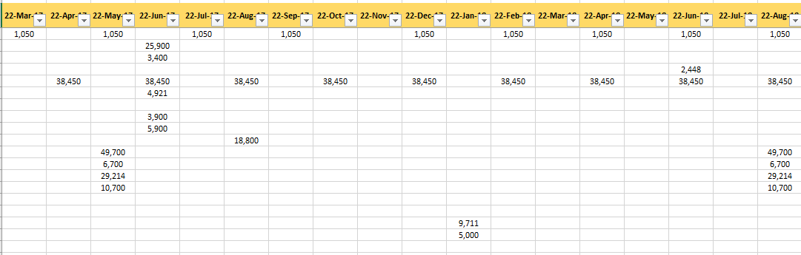
LCMP master sheets are also used to generate schedule of planned activities which then used to estimate the total costs over the year
IN
PROCESS
OUT
MVP
Schedules are generated automatically based on magnitude of frequency, current SMU Hr, and last done
This page involves automatic-scheduling using complex calculation (Please see the formulas on the excel file). Scheduling is the core function of LCMP which determine the calculation of downtime hours, maintenance costs, and equipment availability

Slide 15
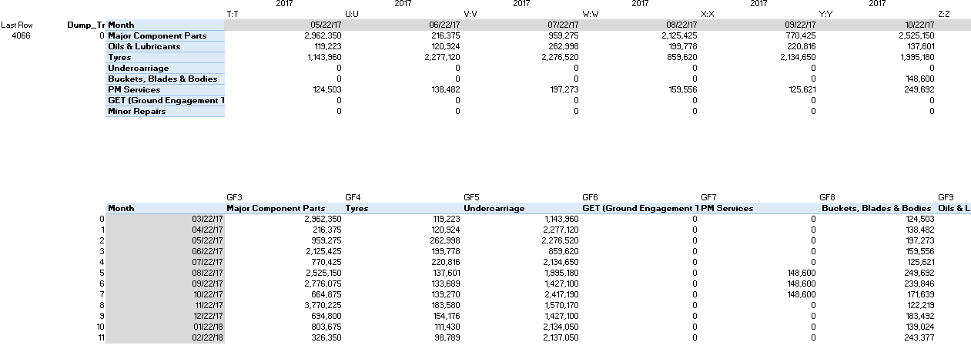
Analysis sheet is used to perform background calculation for determining costs in multiple conditions
IN
PROCESS
OUT
SUMIFS formulas are used to calculate the costs of certain cost centre in specific time
INDEX-MATCH functions are used to lookup costs of certain cost centre in specific time
SUMIFS and INDEX-MATCH function are the two basic formula used in the analysis. The results are presented in the output sheets

Slide 16
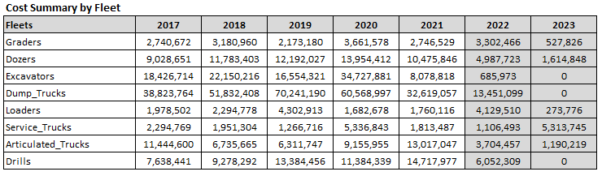
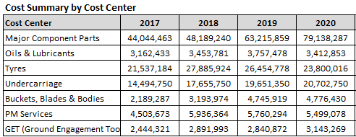
The overall summary of costs are presented in the LCMP dashboard
IN
PROCESS
OUT
MVP
This is the main dashboard used by Mobile Fleet Maintenance leadership to do the review on equipment strategies

Slide 17
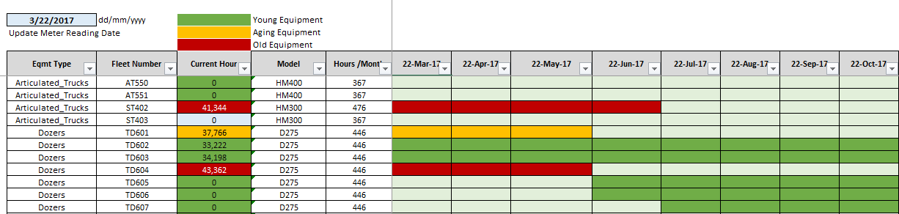
User can also modify equipment strategy by turning ON/OFF equipment to get the desired availability with decent costs
IN
PROCESS
OUT
MVP
Turning equipment ON/OFF will change availability performance
User turn OFF the old equipment to improve availability
New equipment is turned ON to replace the old one

Slide 18
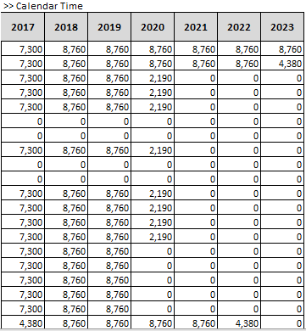
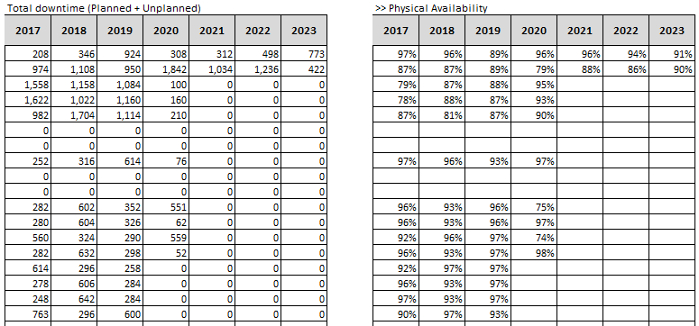
Downtime hours analysis and availability calculation are performed in the dashboard sheets
IN
PROCESS
OUT
Total calendar time is calculated based on SMU hours
Total downtime is the sum of total planned and unplanned downtime hours
Availability is calculated based on total downtime and total calandar hours
Downtime hours and availability are mainly driven by the planned activities defined in maintenance strategies and the underlying assumptions determined in the input sheets

Slide 19
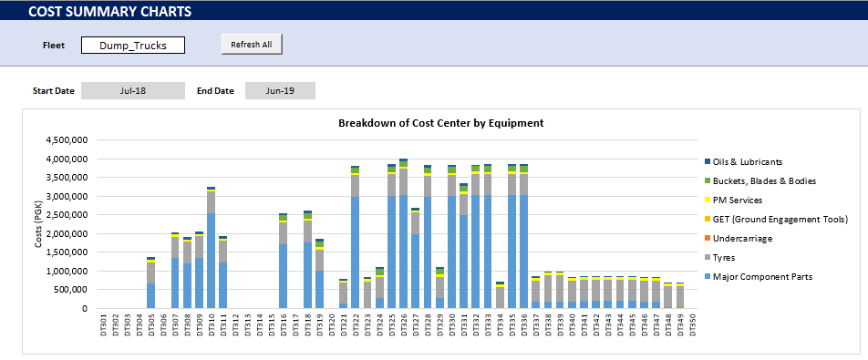
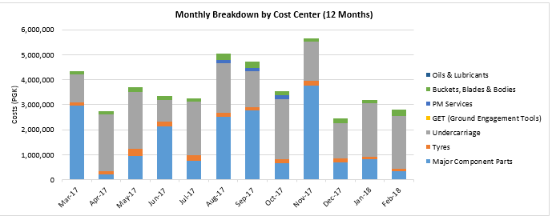
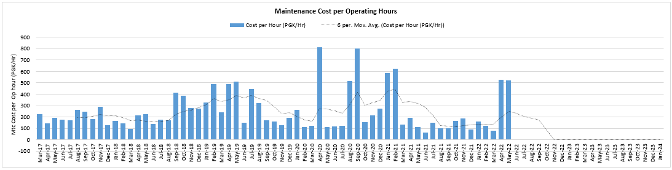
Analysis on equipment strategies are presented in charts format to help Mobile Fleet Maintenance Leadership to make decision
IN
PROCESS
OUT
Costs breakdown by equipment
Costs breakdown by Cost Centre
Costs per Operating Hours

Slide 20
LCMP tool should be able to generate cost breakdown summary by cost-centre which required by Finance group
IN
PROCESS
OUT
MVP
Costs centres used by Finance for official budgeting
Send button to generate and send report to Finance group
This is the core report produced by Mobile Fleet Maintenance department every year for budgeting purpose

Slide 21
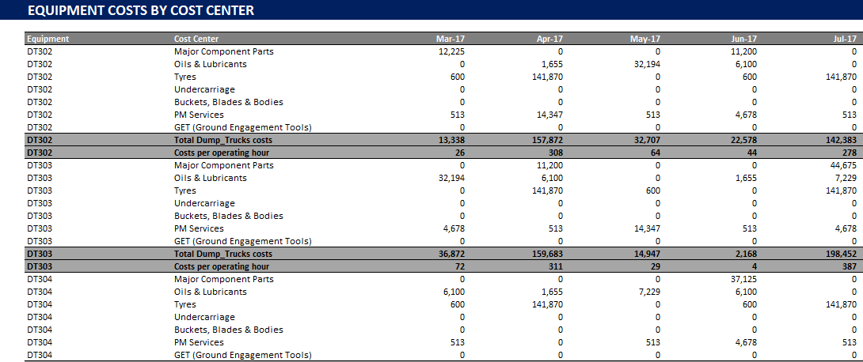
Cost breakdown by equipment is the additional analysis required by Mobile Fleet Maintenance leadership for decision making
IN
PROCESS
OUT
Costs of specific equipment in certain period
Cost per operating hours of the specific equipment
This is the additional report used for analysis and decision making

Slide 22
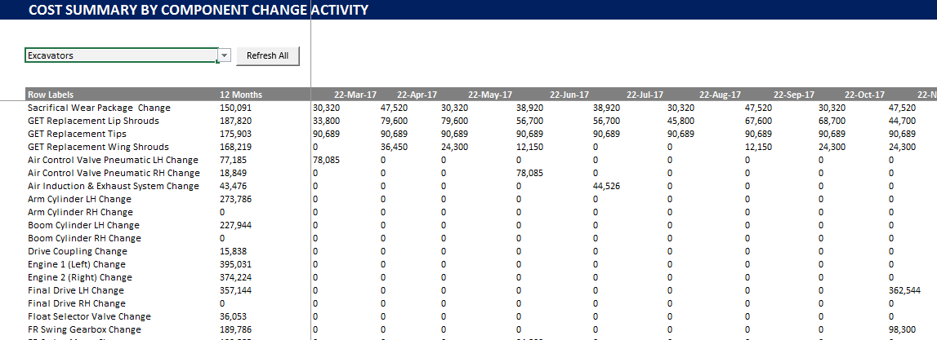
Another additional analysis that useful for Mobile Fleet Maintenance leadership is the cost breakdown by activity
IN
PROCESS
OUT
12 months costs summary
Cost by specific activities in certain period
This is the additional report used for analysis and decision making

Slide 23
Finally, Mobile Fleet Maintenance leadership can use LCMP to estimate required headcount in the organisation
IN
PROCESS
OUT
Labour hours required, estimated based on planned and unplanned hours
Headcounts estimation by role, estimated based on labour hours

Slide 24
Next steps for LCMP product development
What | Who | When
Articulate the idea via e-mail / phone call to Menno / Grace to test viability | Vitaly | Done
Shortlist possible approaches and suppliers we will go to for development | Vitaly | Done
Prepare a functional specification for the software | Herman | Done
Prioritise the elements of the app and define Minimum Viable Product (MVP) | Paul | 15 Jun
Identify 2-3 champions in PIP who can provide an independent view/input on functional spec | Vitaly | Jun May
Send MVP specification and XLS file to the shortlisted developers and get quotes back | Menno | 22 Jun
Hold Q&A calls with the suppliers to confirm their understanding and to refine quotes | Vitaly/Paul | 30 Jun
Engage the preferred supplier in development | Menno | 15 Aug
Beta test the software and ask the suppliers to fix identified bugs | Herman | 22 Aug
Road test the software on site with the client | Paul | 30 Aug
Develop documentation and add to PIP methodology | Herman | 30 Aug
Define the pricing structure for the software and add into pricing models | Menno | 8 Sep

